Slide 1
MAX Project at Planned Parenthood Mohawk Hudson - Behavioral Health
Utica Center 6/2016 Update

Slide 2
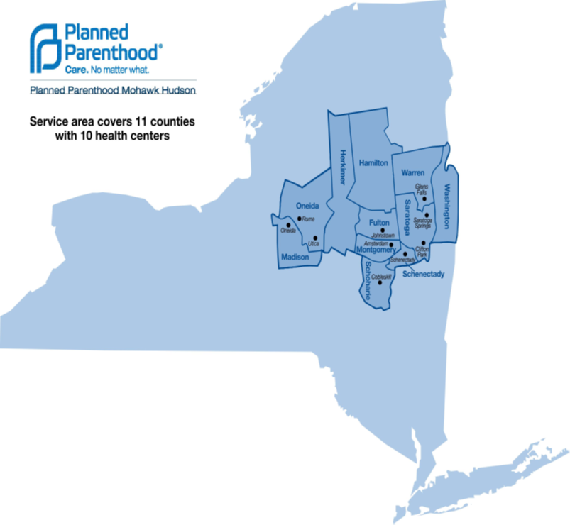
Planned Parenthood Mohawk Hudson (ppmh) Overview
As a whole, the affiliate served a total of 20,314 unduplicated patients in 35,506 visits in 2015.
PPMH is associated with 5 PPS in NYS
CCNYC
AHI
ABH
AMC
LCHP

Slide 3
PPmh Western Region Overview – Utica/rome/oneida
Total of 7,175 patients served in this region for 2015
Utica –3,691 unduplicated patients and 6,615 visits
Rome –1,875 unduplicated patients and 3,349 visits
Oneida –1,609 unduplicated patients and 2,766 visits

Slide 6
Project Description
PPMH Vision “To create an interdisciplinary health and wellness environment for the community that can assess factors that impact health and wellness, overcome barriers to care, provide care that achieved measurable outcomes and patient goals.”
PPMH Goal “To provide (as measured by no-show rate) deliverable, effective (as measured by a decrease in PHQ 9 scores and meeting patient goals) behavioral health services to 100% patients in need (as determined by a positive PHQ9 or clinical judgment) in a financially sustainable way (as measured by a 0 deficit).”

Slide 7
Partner participation
PPMH is co-locating with Psychological Healthcare, LLC. Based in Syracuse, they have over 70 providers who specialize in various areas of behavioral and psychological healthcare.
In the future, PPMH will be looking to partner with other Planned Parenthood affiliates to offer Primary Care services
PPMH is actively pursuing relationships with other community partners, such as Community Health and Behavioral Services and The Neighborhood Center
PPFA is our partner to expand Telemedicine services/Tele-behavioral Health

Slide 8
Project Description
PPMH began completing a PHQ2/9 screening for all patients presenting for their Annual Exam or Initial Office Visit in July 2015
March 21, 2016 we began screening ALL patients. Our cohort for the MAX Project is females, aged 18-34, who are currently using a Medicaid insurance product or are self-paying for services.
Prior to March 2016, we were screening an average of 58 patients per month. Since March 21, 2016 this has increased to about 282 patients per month.
As of June 9th, 2016 we have begun co-locating with Psychological Healthcare, LCC. We have a psychologist on site ½ day per week to provide counseling services to patients who either score on the PHQ9 or who are referred based on clinical judgement of the PPMH provider.

Slide 9
Implementation process
MAX Project began in December 2015
Workshop #1 (February 2016) - focus on expanding the PHQ2/9 and laying the groundwork to get Lesley on-site
De-duplicate clinical workflows
Set up a weekly touch-base meeting with Action Team members
Expand the PHQ2/9 screening
Workshop #2 (April 2016) – focus on the operational aspects of co-location (i.e. workflows, documentation, patient goals, and building relationships with other area providers).
Develop clinical workflow algorithm
Develop a system for documenting and tracking patient goals
Conduct outreach to other area behavioral health providers
Workshop #3 (June 2016) – focus on cementing current co-location services and expanding into telehealth service delivery.
Establish TruClinic platform in Utica/western sites
Education and training of staff/other area providers. Community outreach and advertising of newly offered services.
Establish Primary Care Services

Slide 10
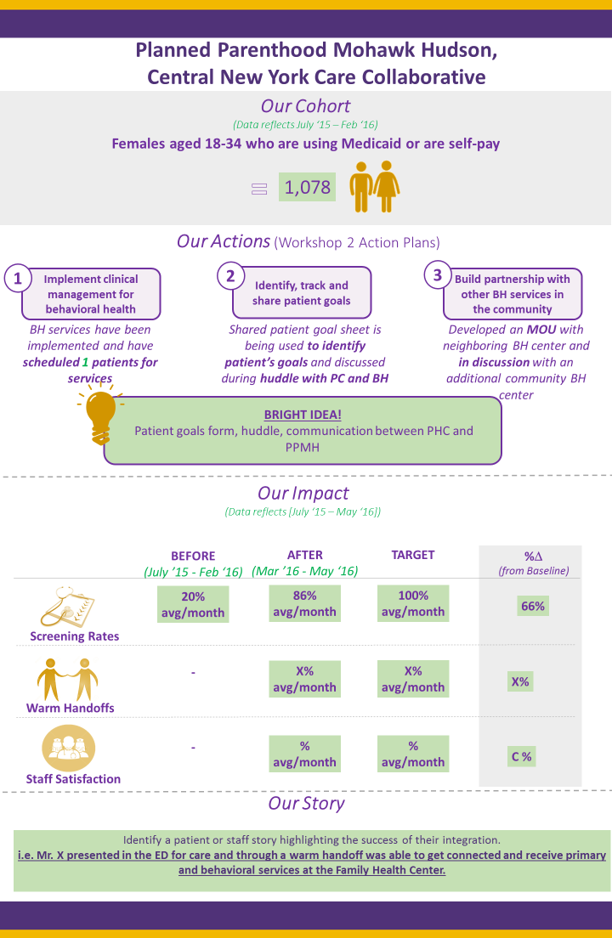
Metrics
Prior to starting MAX, we were screening about 20% of patients.
We are currently screening 86% of patients within our cohort, with a goal of screening 100%

Slide 11
Metrics

Slide 12
Partner Outcomes
Psychological Healthcare is potentially expanding their range via telehealth to cover our entire affiliate geography.
Psychological Healthcare will be able to fill provider slots via Telehealth by being more efficient.
Matching of specific patients with providers who specialize in targeted diagnoses or therapies.
We have a full time grant writer who can locate and apply for grants to expand PHC’s revenue sources.

Slide 13
Success and challenges to date
Successes
Streamlined clinical workflows
Screening more patients for PHQ2/9 and capturing more patients in need
Developed clinical management algorithm that can be translated across the affiliate as this service grows
Starting to build important partnerships within the Utica behavioral health community
Currently screening (on average) 86% of patients within the cohort for PHQ2/9
Patients have been scheduled to see a Behavioral Health provider directly at our Utica Center
Challenges
Coordinating communication and documentation between two separate offices
Coordinating billing/banking (not only between offices but also with state/Medicaid/insurances)
Long term sustainable billing model requires regulatory changes.

Slide 14
Additional Observations
Patients are extremely grateful to be able to come to PPMH for behavioral health services. They are comfortable with our providers and trust PPMH.
Staff are really excited about being able to offer this service to patients, as they have long recognized the huge, unmet need for behavioral health services in the area

Slide 15
Questions?

